Slide 1
Financial data analytics
Made by Preity Vasudevan Kondath

Slide 2
Introduction
In today's competitive business landscape, understanding the market and analyzing competitors is crucial for a company's survival and growth.
This analysis provides valuable insights into market dynamics, trends, and competitor strategies, enabling businesses to make informed decisions and stay ahead of the competition.
In this context, we conducted an analysis of the top 500 companies in India, focusing on key metrics such as market capitalization and quarterly sales. The dataset contains information on the market capitalization of these companies, their sales figures for the quarter, and other relevant attributes.

Slide 3
Details of Dataset
The dataset contains information on the top 500 companies in India, including their market capitalization, sales figures for the quarter, and other relevant attributes. Here are some details about the dataset:
Serial Number: A unique identifier for each company in the dataset.
Name of Company: The full name of the company.
Mar Cap – Crore: Market capitalization of the company in Crores (Indian currency). The market value of a company's outstanding shares, calculated by multiplying the total number of outstanding shares by the current market price per share.
Sales Qtr – Crore: Quarterly sales figure of the company in Crores. The total revenue generated by the company during a quarter.
These attributes provide insights into the financial performance and market value of each company in the dataset. Analyzing this data can help identify trends, compare the competitiveness of different companies, and understand the factors driving market capitalization and sales growth in the Indian market.

Slide 4
Major KPI’s
Market Capitalization (Mar Cap): This is a primary indicator of a company's value in the stock market and its competitiveness within its industry.
Quarterly Sales (Sales Qtr): Quarterly sales figures reflect the revenue generated by a company over a specific period, indicating its performance in generating income.
Market Capitalization to Sales Ratio: Calculated by dividing market capitalization by quarterly sales, this ratio provides insights into how efficiently a company is valued relative to its revenue generation.
Growth Rate: The rate at which a company's market capitalization or sales is increasing over time, indicating its potential for expansion and competitiveness.
Market Share: The portion of total market sales or market capitalization that a company holds, indicating its position relative to competitors in the industry.

Slide 5
Major KPI’s
Profit Margin: Calculated by dividing net income by revenue, this metric indicates the percentage of revenue that translates into profit after accounting for all expenses.
Return on Investment (ROI): This measures the profitability of an investment relative to its cost and is calculated by dividing the net profit by the initial investment.
Debt-to-Equity Ratio: This ratio compares a company's total debt to its shareholders' equity and reflects its ability to meet its financial obligations.
Earnings Per Share (EPS): This measures the amount of a company's profit allocated to each outstanding share of its common stock and is an important factor for investors.
Price-to-Earnings (P/E) Ratio: Calculated by dividing the market price per share by earnings per share, this ratio indicates how much investors are willing to pay for each unit of earnings.

Slide 6


ANALYTICS DASHBOARD
500
Total Number of Companies
28.04K
Average Market Capitalization (in Crores)
4.4K
Average Quarterly Sales (in Crores)

Slide 7
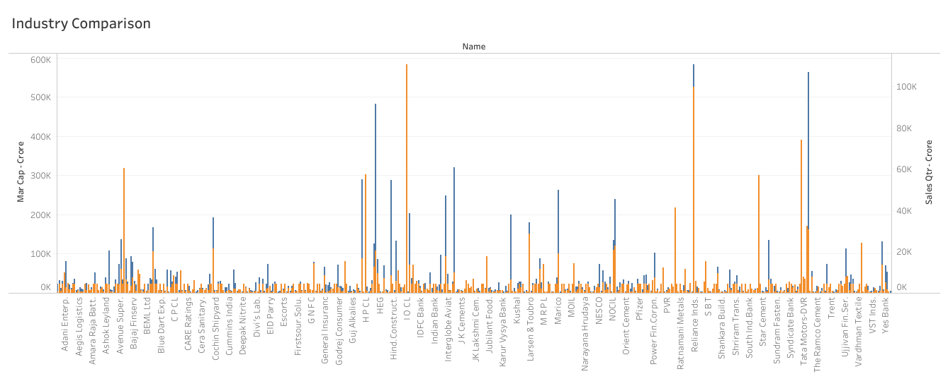


Slide 8
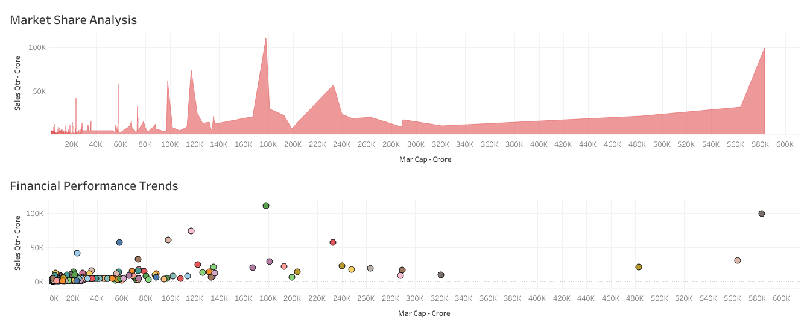

Slide 9


